Slide 1
Digital Accessibility and Security
Responsibilities for Websites
January 2021

Slide 2
Presenters
Ben Rissman, Assistant Vice President, Digital Communications
Liz Honig, Director, Office for Access and Equity
Pat Kogos, Director, Digital Accessibility, IT Services
Jason Edelstein, IT Risk and Compliance Program Manager, IT Services
Cornelia Bailey, Director of Strategy and Relationships, IT Services

Slide 3
Overview
Why are website security and accessibility important?
Web policies and standards
Security and maintenance fundamentals
Digital accessibility fundamentals
University resources
Action plan
Q & A

Slide 4
The Importance of
Website Security and Digital Accessibility

Slide 5
Website security and digital accessibility at UChicago
Web properties are websites and applications the University uses for academic, research, and communications purposes. The University has more than 5,000 web properties.
The security of these web properties is of vital importance to the University, as is making web content accessible to all members of the community.
With this in mind, in 2018 the Provost charged IT Services with remediating risks associated with web properties and implementing standards that enable the University to sustainably manage these properties going forward in a secure and inclusive manner.
IT Services has partnered with the Office of the Provost's Equal Opportunity Programs, Student Disability Services, and University Communications, and worked with faculty, IT leaders, and staff from across the University to gain alignment and address accessibility needs with new resources.

Slide 6
What could happen if a web property is not secure?
Potential scenarios include:
Data breach or exposure of sensitive information
Defacement (e.g., posting inflammatory information)
Criminals attacking website visitors with malware or viruses
Theft of accounts and passwords which could then be used for malicious purposes on other systems (e.g., phishing)
Being taken offline by University Information Security, leading to interruption of service

Slide 7
Why is digital accessibility important?
Web properties should be easily navigated and understood by a wide range of users, including users with disabilities
Offers a better user experience for everyone
Strengthens our commitment to an accessible, diverse, and inclusive working and learning environment
Our digital representation online should reflect our academic excellence
Strengthens the University’s compliance regarding accessibility laws and reduces our risk
Enhances Search Engine Optimization (SEO)

Slide 8
Web Policies and Standards

Slide 9
New UChicago web policies and standards
Two new policies have been created (found at https://its.uchicago.edu/it-policies/)
Web Properties Management Policy
Digital Accessibility Policy
They support the University’s priorities of inclusiveness, security, and academic excellence
They apply to any unit, school, division, department, group, or individual that has or manages a University of Chicago web property
Accompanying standards explain how to meet the policy’s goals.
One new set of standards supports both policies:
Web Properties Management Standards (found at https://websites.uchicago.edu)

Slide 10
Web Properties Management Policy
University web properties should be
Secure and maintained – expectations that CMSs, servers, and custom code be up-to-date
Accessible – to all users, including users with disabilities
Follow standards for domain names – where to apply for a domain name, guidelines for choosing a domain name (see websites.uchicago.edu)
Registered – via a short form asking for basic ownership, platform, hosting of the website (see websites.uchicago.edu)
The Chief Information Officer (CIO) is responsible for the Web Properties Management Policy.

Slide 11
Digital Accessibility Policy
Summary Overview:
New web properties or those undergoing substantial revisions or redesign after September 1, 2021 are required to conform to the Standards.
New digital content must conform to the Standards after September 1, 2021.
If an existing University Web Property will not undergo substantial revisions, redesign, or make use of new digital content for the foreseeable future, the site owner should use best efforts to make the Web Property conform to the Standards.
If the University receives a request from an individual who is unable to access content on a University web property for reasons of a disability, the site owner must, in a timely manner, either update the requested content to conform to the Standards, or make the content available in an alternative format.
The Associate Provost for Equal Opportunity Programs, ADA/504 Coordinator and the Chief Information Officer (CIO) have responsibility for the Digital Accessibility Policy.

Slide 12
Do these policies apply to my website?
The policy applies to any University Web Property, that is, any website or web application “owned or controlled by the University or operated by or on behalf of the University.”
Examples include:
A website using a University domain name, or a website redirected from a University domain name.
A website without a University domain name (and is not redirected from a University domain name) but:
  is used for University business. University business includes, but is not exclusive to teaching, publishing research, marketing university events, university groups, research labs.
  uses University branding and logos.

Slide 13
When do the policies not apply?
The policies may not apply to some web properties, even if they reference the University. Examples include:
A website without a University domain name that does no University business or bears University logos (e.g., professorswebsite.wix.com site with no branding, only CVs, photos, blog).
If a web property is not subject to the University policies, site owners should still ensure that the property is accessible, secure, and maintained. These practices benefit the owners and reduce risk to reputation and security.
If you have questions about the policy, please contact webhelp@uchicago.edu.

Slide 14
Security and Maintenance
Fundamentals

Slide 15
What makes a secure web property?
Current and supported technologies
  When upgrading technologies or starting a new project, be sure to only use supported and up-to-date software that is actively receiving security patches by an established, reputable vendor (e.g., Microsoft, Oracle) or open-source community (e.g., Drupal, WordPress).
Security updates
  Critical patches must be applied within 30 days. All other patches must be applied within 90 days.
Secure development practices
  If a site includes web applications, it must address common security issues as outlined by the Open Web Application Security Project (OWASP) Top Ten Project and follow industry-accepted secure coding practices.
Electronic payments and Payment Card Industry (PCI) compliance
  If a site will accept electronic payments, the site owner must work with the Bursar’s office to receive approval.

Slide 16
What do website owners need to do to comply?
When buying a product or developing a new web property, have a plan to maintain it going forward. Budgets may be required for patches, maintenance, or other requirements.
Understand who “owns” a web property – what happens if the website manager changes jobs or leaves the University?
Be prepared to take quick action if there is a security issue and stay connected with your local technology team.
Keeping a website secure is a continuous process.
For security questions, please contact your local technology teams or the University Information Security team at security@uchicago.edu or 773.702.CERT.

Slide 17
Digital Accessibility
Fundamentals

Slide 18
Who is impacted if content is not accessible?
Users with disabilities:
Auditory
  deafness, hard of hearing
Cognitive
  Dyslexia, attention deficit disorder
Motor
  arthritis, muscular dystrophy
Neurological
  epilepsy, migraines
Speech impairment
Visual
  blind, visually impaired, color blind
Other users:
People utilizing various screen sizes, sometimes with a fixed view
Older people with changing abilities
Users with temporary disabilities
  a broken arm or eye surgery
People with situational limitations
  in the bright sunlight or a loud environment
Users with slow internet connections
Anyone using assistive technology like a screen reader

Slide 19
Disabilities by the numbers
UChicago Disability Statistics
Undergraduate
8% of students have registered a disability with Student Disability Services (SDS)¹
18% self-identify as having a disability²
Grad/Professional
3% of students have registered a disability with SDS¹
13% self-identify as having a disability²
U.S. Disability Statistics³
1 in 5 people in the U.S. have a disability.
8.1 million people have some form of visual impairment, including 2 million who are blind or unable to see.
7.6 million people have difficulty hearing, including 1.1 million whose difficulty is severe.
19.9 million people have difficulty lifting or grasping objects.
¹ UChicago data as of Spring 2019
² 2016 Campus Climate Survey
³ U.S. Census 2010

Slide 20
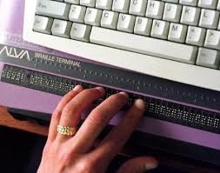
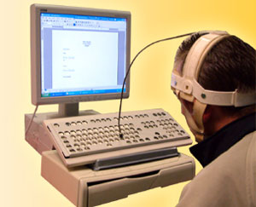
How do people with disabilities navigate websites?
Users with disabilities often employ assistive technology to interact with digital content, including websites.
Examples of assistive technology:
  Screen reader software
  Pointing devices
  Alternative keyboards
    including refreshable Braille
  Eye gaze technology
  Voice recognition software
Refreshable Braille keyboard
Head pointer

Slide 21
Basic principles of digital accessibility
Appropriate alternate text (alt text) for images and controls
Headings: proper mark-up; nested in order (H1, H2, H3)
Captions, transcripts, and audio descriptions for multimedia, including social media posts
Sufficient color contrast (e.g., text against background, link text against surrounding text, interactive elements against background)
Color alone should not convey meaning (e.g., red to indicate an error)
Meaningful link text
  Describe where the link will take the user instead of “click here.” Don’t use the URL as link text.
Visible focus indicator (to show where a user is when tabbing through a webpage)
All text can be resized up to 200% without loss of content or functionality
Accessibility is abbreviated “a11y” (pronounced “ally”)
derived by replacing the middle 11 letters of the word “accessibility” with the number 11

Slide 22
How do screen reader users access content?
According to a recent Screen Reader Survey¹, most screen reader users find information on a web page in the following ways, by order of frequency. They often utilize hot keys to access navigation features.
Navigate through headings
Use the “Find” feature
Read through the page
Navigate through links
Navigate through landmarks/regions
¹ WebAIM Screen Reader User Survey #8 (https://webaim.org/projects/screenreadersurvey8/#finding).

Slide 23
What standards are used to assess web accessibility?
Web Content Accessibility Guidelines (WCAG) were created by the World Wide Web Consortium (W3C), a group that develops international standards for the Web.
WCAG includes three levels of conformance
  Level A (most basic; high user impact)
  Level AA (industry and UChicago standard; includes Level A)
  Level AAA (most stringent; most difficult to achieve)
The current version is WCAG 2.1, adopted June 2018
  WCAG 1.0 was adopted May 1999
To meet the University’s Digital Accessibility Standards, all web properties shall:
comply with WCAG 2.1 AA
have an “Accessibility” link in their footer that links to accessibility.uchicago.edu

Slide 24
Legal guidelines
The Department of Justice (DOJ) has continually reaffirmed that the Americans with Disabilities Act (ADA) of 1990 applies to websites as “places of public accommodation.”
Web Content Accessibility Guidelines (WCAG) are consistently upheld as the prevailing standard by the DOJ and the courts.
“How many opportunities do we have to dramatically improve people’s lives just by doing our job a little better?”
― Steve Krug
Don’t Make Me Think: A Common Sense Approach to Web Usability
Bureau of Internet Accessibility, “Is There a Legal Requirement to Implement WCAG?”, https://www.boia.org/blog/is-there-a-legal-requirement-to-implement-wcag

Slide 25
Evaluating web accessibility
Free, automated tools are available to help evaluate a website’s accessibility. These tools can identify less than 50% of the issues, but they are a great start.
Manual testing must be performed to find the rest of the issues. Manual checks include:
  Keyboard testing (some people can’t use a mouse)
    All content and functionality must be accessible using only the keyboard
    Keys used for navigation: Tab, Shift+Tab, arrow keys, space bar, Enter
  Screen reader testing
    Most popular for Windows: JAWS ($), NVDA (free)
    iOS and MacOS: VoiceOver (included)

Slide 26
Digital accessibility as part of the process
Planning for digital accessibility and building it into our processes is much more efficient and effective than trying to remediate accessibility issues after the fact.
Digital accessibility is a process, not a project. Our efforts will be ongoing as we continue to strive toward greater accessibility.
We are responsible for the accessibility of all systems we offer, whether they are developed by us or an outside vendor.
Ensure accessibility and budget for related expenses throughout:
  Procurement of third-party systems
  Software and web development, including ongoing maintenance
  Document creation and maintenance, including PDFs
  Media and social media creation, including descriptions of images, video, and audio
  Instructional design
  Project life cycles
  Webinar and remote meeting planning, including captioners and interpreters as needed

Slide 27
Who is responsible for digital accessibility?
Site Owners have primary responsibility for
ensuring that the web properties for which they are responsible conform to this Policy
educating and training people who contribute to those sites on the requirements of this Policy and the tools and methods for conforming with it
Site Owner: An individual designated responsible for one or more University Web Property(s).
The University provides resources to support digital accessibility, including the Center for Digital Accessibility (CDA) in IT Services.
Notes:
:

Slide 28
Get started with digital accessibility
Learn more about website accessibility
Don’t be intimidated or worry that the task is too daunting; make a best effort by
  Focusing on removing barriers
  Working toward greater accessibility over time
Start making easy changes first
  Missing alt text for images and interactive elements (e.g., buttons)
  Missing captions and audio descriptions
  Headers that aren’t marked up properly
  Color contrast issues
  Missing focus indicators
  Site-wide issues (link style, header, footer)
Prioritize
  Issues with highest user-impact (e.g., keyboard accessibility)
  New websites and content

Slide 29
University Resources

Slide 30
Resource planning and support
There may be costs associated with making needed changes to be in compliance with the new policies. You are encouraged to discuss this with your unit budget manager.
There are many things you can do to strengthen your compliance without incurring any expense, including:
  Security: Reduce risk. Sometimes, making simple choices about product configurations or data can avoid compliance or security costs.
  Digital accessibility: Address some of the “easy changes” mentioned earlier, like adding alt-text to images and creating meaningful link text.
The University has provided organizational resources to assist with this effort:
  Website Resource Center
  Center for Digital Accessibility
  Enterprise accessibility tool

Slide 31
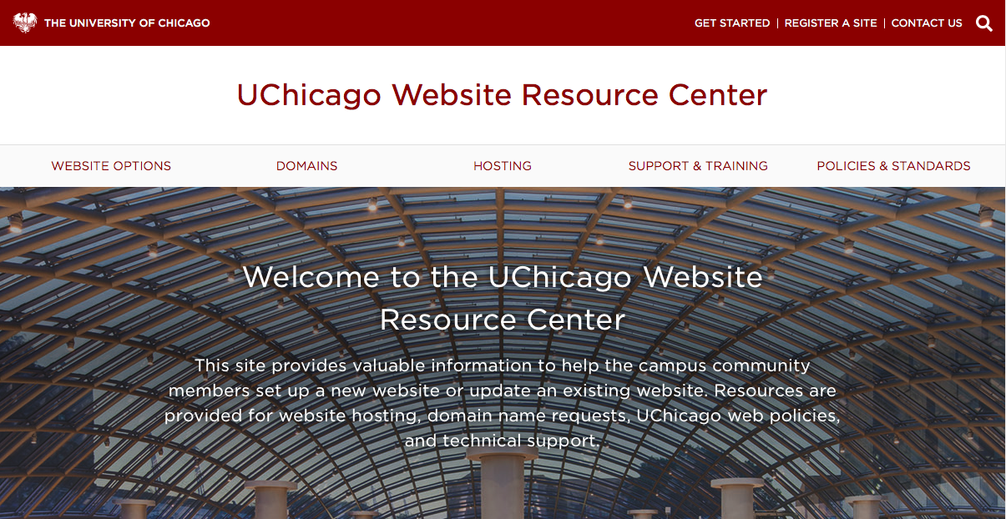
Website Resource Center
A website that provides web-related services and information:
University web policies & standards
Website registration
Domain name requests
Website hosting options
Training and support materials
On-campus and preferred vendor solutions for website development
Website Resource Center website URL:
https://websites.uchicago.edu

Slide 32
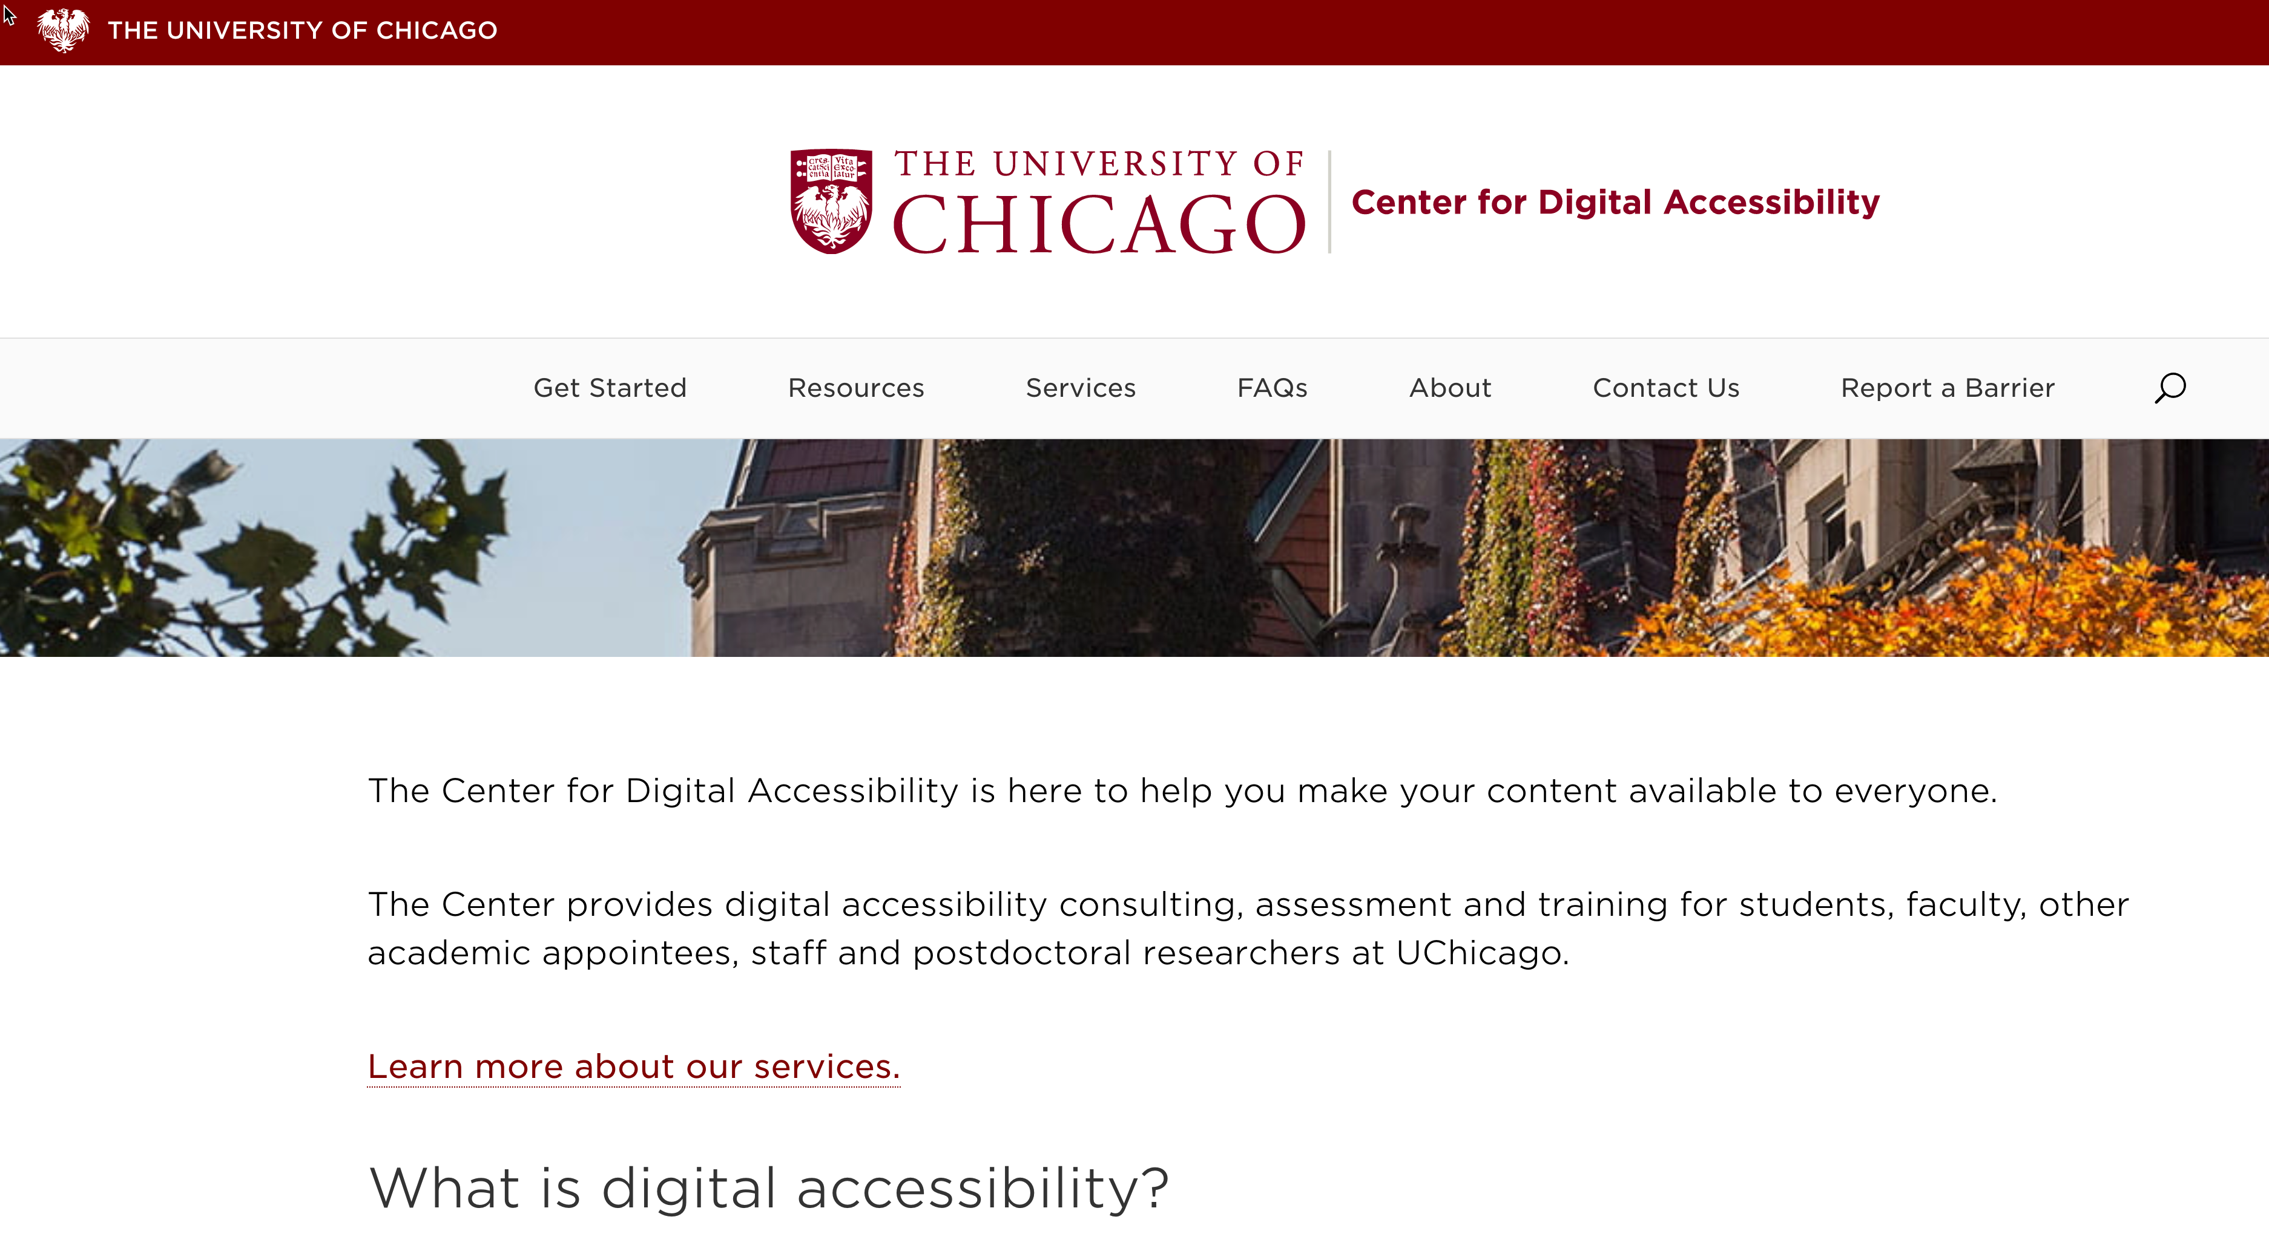
Center for Digital Accessibility
The CDA is a resource in IT Services (launched in Jan. 2020).
The CDA provides services related to digital accessibility:
  Consulting (guidelines and implementation of standards)
  Evaluation (tools and support for assessing digital content)
  Training (custom training and links to resources)
Staff:
  director and three digital accessibility specialists
Center for Digital Accessibility website URL: https://digitalaccessibility.uchicago.edu

Slide 33

Enterprise accessibility tool
The University has procured Siteimprove to assist site owners, web developers, designers, and content editors identify and remediate accessibility issues discoverable via automation.
  Note: Keyboard and screen reader testing should be used to find and remediate issues discoverable via manual testing. Visit the CDA Get Started page to learn more.
Siteimprove provides a suite of web-based tools that regularly scans websites. It detects and reports on issues affecting accessibility, content quality, search engine optimization, and more. Siteimprove’s web accessibility tools enable you to easily:
  Find and fix accessibility issues using the WCAG 2.1, AA guidelines
  Set priorities for addressing accessibility issues
  Schedule reports and track improvement over time
Visit the CDA website to learn more about how to start the Siteimprove onboarding conversation.

Slide 34
Action Plan

Slide 35
Next steps
Review the Policies and Standards.
Review your website(s) using the Standards as a guide.
Remediate issues to improve safety and accessibility.
If you are a web property owner:
1) register your website, 2) provide contact info of the people who are responsible for the site.
9/1/2021:
Continue to ensure the safety and accessibility of your website(s).
January 2021:
Policies are announced
Reach out to the Center for Digital Accessibility (CDA) or Website Resource Center as questions arise.

Slide 36

Questions
For more information:
Center for Digital Accessibility: digitalaccessibility.uchicago.edu
Website Resource Center: websites.uchicago.edu
Policies: its.uchicago.edu/it-policies/
Additional questions?
General: webhelp@uchicago.edu
Accessibility-specific: digitalaccessibility@uchicago.edu
Security-specific: security@uchicago.edu

